Slide 1
PEAKY
WRITTEN & DIRECTED BY
LOKESH DHRUVA

Slide 2
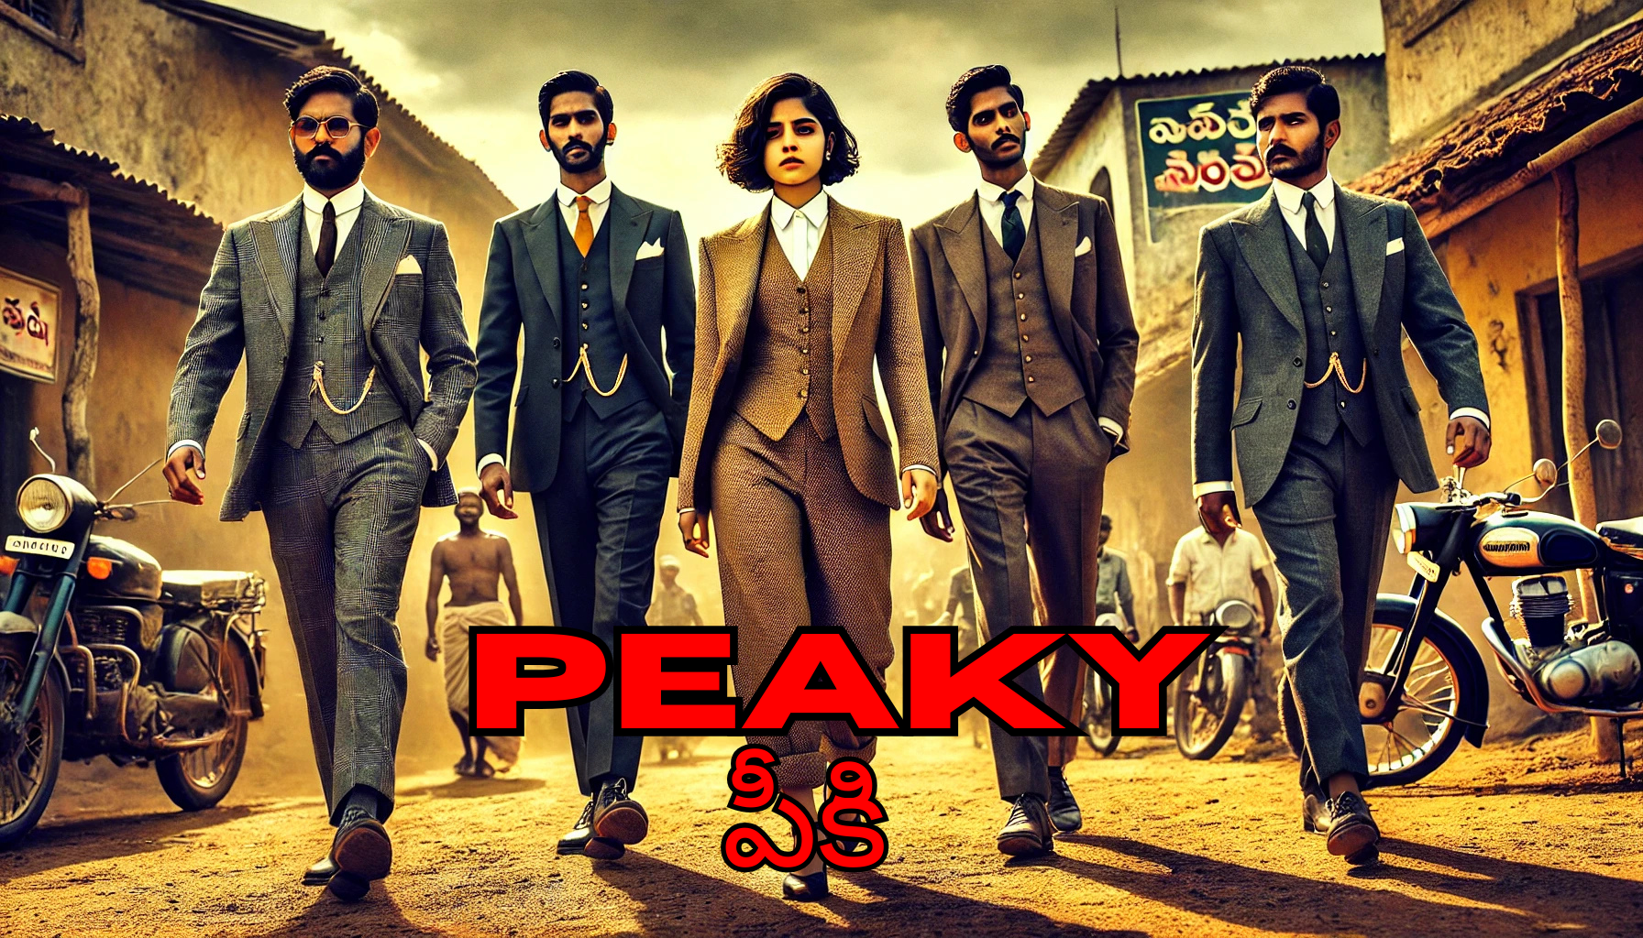
STORY OUTLINE:
Peaky and his friends, frustrated by the lack of opportunities in their village, decide to build their own future instead of migrating to the city. As they establish a unique profession solving land disputes and protecting locals, they accidentally uncover a massive underground cocaine smuggling network. With intelligence, bravery, and teamwork, Peaky takes on the ruthless drug syndicate, dismantles its operations, and earns both wealth and respect—all while proving that success and honor can be achieved without leaving home.
The ultimate situational comedy and action story.

Slide 3
THE VILLAGE HUSTLE
ACT 1

Slide 4
THE PEAKY GANG

Slide 5
PEAKY GANG INDIVIDUAL PRACTICE OF BODY AND MIND

Slide 8
TAKING PEOPLES PROBLEM IN PEAKY SPOT

Slide 9
GANG RIDING IN A BULLET BIKE TO SOLVE CASES:
The entire gang ride around te village lanes in a single bullet bike, to solve the cases and problems of the people

Slide 10

Firstly Dealing funny & petty cases
Dealing the gold ring case, Funnily interrogating the children about the gold ring

Slide 11
In the process of dealing the egg case they disturb the whole hens and, escape without showing their faces to the owner, to maintain their fame
FAILED EGG CASE:

Slide 12
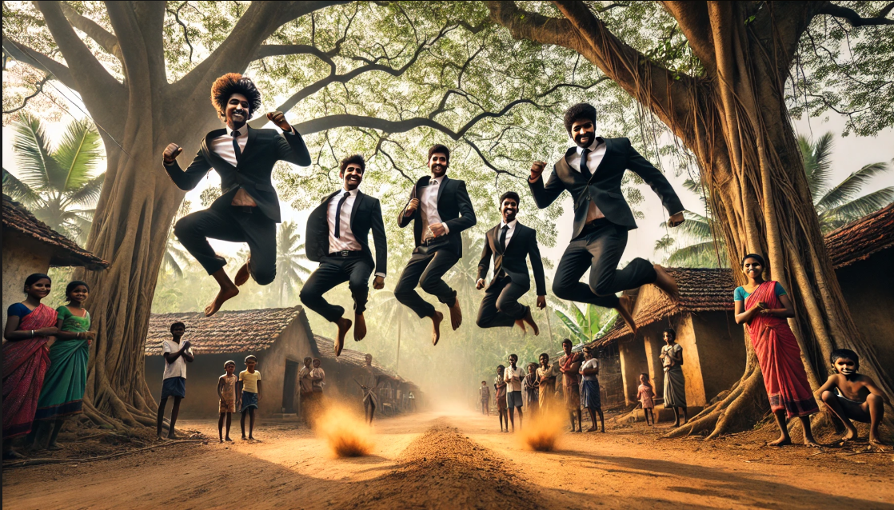
THE RULE: LEMUR JUMP
The rule is whenever somebody in the gang gets angry they jump like lemurs

Slide 13
Tackling the DRUG racket
ACT 2

Slide 14
THE INFLUENCED AND POWERFUL DRUG DEALER FROM VIZAG
Rashid, a ruthless enforcer and key player in the drug trade, operates from the shadows, using fear, violence, and deep underworld connections to keep the empire running smoothly.

Slide 15
The bike serves as a crucial link in the drug trafficking network, secretly used to transport cocaine across locations, the mega bike which leads to downfall of the entire cocaine network across the country
THE MEGA BIKE

Slide 16
MEGA BIKE CAPTURED BY PEAKY GANG
The Peaky’s gang acquires the bike when the police impound it during a routine checkpoint, unaware it contains hidden cocaine. Attempting to retrieve it for quick cash, they outsmart a rival gang, unknowingly stepping into a dangerous drug conspiracy.

Slide 17
BRUTALLY BEATEN
By the order of Rashid, to take the bike, Rashid’s men cathes Max when he’s alone, brutally beating him to send a warning to the Peaky’s gang. The attack leaves Max severely injured, fueling Peaky’s anger and determination.

Slide 18
Peaky Gang Enters into Vizag
After Max’s brutal beating, the Peaky’s gang tracks Rashid to Vizag using their local connections. Determined to take revenge, they gather intel on his hideout and plan a surprise attack. Arriving in Vizag,

Slide 19
CLIMAX BRUTAL FIGHT WITH RASHID GANG
Climax, known for his brute strength and fearless combat skills, takes on Rashid’s gang inside the factory, single-handedly overpowering multiple opponents. Using metal rods and raw force, he dismantles Rashid’s enforcers, turning the tide of the battle. In a final showdown, he takes down Rashid’s strongest fighter, proving his dominance and solidifying Peaky’s gang’s victory.

Slide 20
PEAKY GANG BACK TO HOME
As Climax holds off Rashid’s gang, Nakshatra enters the scene, fearlessly taking on the attackers with swift and precise moves. Using her agility and combat skills, she fights off multiple enforcers, backing up Climax in the intense battle. Together, they overpower the gang, turning the tide in the Peaky’s favor and pushing toward victory.

Slide 21
A HAPPY MEAL WITH THE FAMILY
After the intense battle, Peaky and his gang reunite with their families, sharing a heartfelt meal together. Laughter and relief fill the air as they celebrate their victory, finally free from the chaos of the past. With their loved ones by their side, they embrace the peace they fought so hard to protect.

Slide 22
The high-stakes final battle with crime, full of fun & chaos
ACT 3

Slide 23
CID chief handing over the case to peaky gang
Recognizing Peaky’s brilliance, the CID Chief entrusts him with a high-profile unsolved case that law enforcement failed to crack. He believes that the Peaky gang’s unconventional tactics can succeed where others have failed. Peaky accepts the challenge, marking the beginning of their next mission.

Slide 24
PEAKY Hand over the drug lord file to the CID
While solving the case, Peaky’s gang uses humor and creativity, disguising themselves in hilarious getups and staging elaborate tricks to outsmart their targets. From faking arguments to setting up bizarre distractions, they turn the investigation into an adventurous game. Their unconventional methods not only crack the case but also make the journey unforgettable.

Slide 25
THE DOWNFALL OF THE DRUG LORD
THE drug lord’s downfall begins when the Peaky gang exposes his hidden cocaine network, unraveling his carefully built empire. As the CID gathers evidence, his allies abandon him, and his once-untraceable operations collapse. In a final blow, Peaky outsmarts him, leading to his arrest, bringing an end to his reign as the elusive drug kingpin.

Slide 26
Back to the village and do the changes
After solving the case, Peaky’s gang earns both a hefty reward and immense respect from the authorities and their village. Instead of leaving for the city, they invest the money into uplifting their hometown—supporting local farmers, setting up small businesses, and creating new job opportunities. Their success proves that with determination and unity, prosperity can thrive in their own village, inspiring others to build a better future at home.

Slide 27
THE END

